Slide 1
Artificial Neural Networks
(Part I)
Grace J. Hwang
Readings: Chapter 4, Mitchell

Slide 2
Outline
Introduction (Part I)
Transfer Functions (Part I)
Network Structures (Part I)
When to consider neural networks (Part I)
Perceptrons (Part I)
Perceptron training rule (Part I)
Gradient descent (Part I)
Multilayer networks
Backprogation algorithm
Remarks on Backpropagation
Artificial neural networks and deep learning

Slide 3
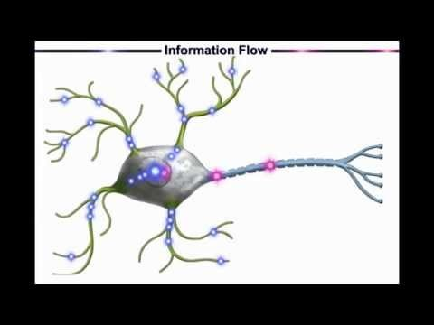
Introduction (1/9)
Biological motivation
  Biological learning system (brain)
    Complex network of neurons
https://youtu.be/gcK_5x2KsLA

Slide 4
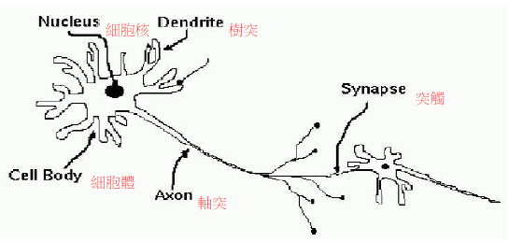
Introduction (2/9)

Slide 5
Introduction (3/9)
A neuron consists of a cell body (細胞體) , dendrites (樹突) and an axon (軸突).
Neurons are massively interconnected, where an interconnection is between the axon of one neuron and a dendrite of another neuron.
This connection is referred to as a synapse
(突觸).

Slide 6
Introduction (4/9)
Signals propagate from the dendrites, through the cell body to the axon; from where the signals are propagated to all connected dendrites.
A signal is transmitted to the axon of a neuron only when the cell “fires”.
A neuron can either inhibit (抑制) or excite
(激發) a signal.

Slide 7
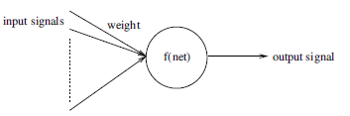
Introduction (5/9)
An artificial neuron人工神經元 (AN) is a model of a biological neuron 生物神經元 (BN).
  Based on model of brain
  Network of simple units
  Real-valued (實數值) inputs & outputs

Slide 8
Introduction (6/9)
Biological Neuron
Artificial Neuron

Slide 9
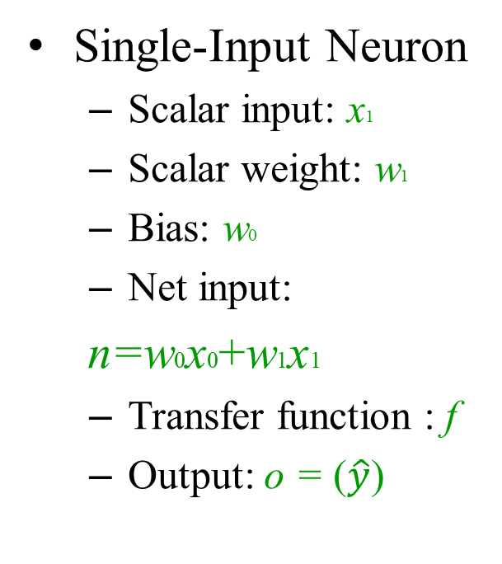
Introduction (7/9)
Single-Input Neuron
  Scalar input: x1
  Scalar weight: w1
  Bias: w0
  Net input:
n=w0x0+w1x1
  Transfer function : f
  Output: o = ($\hat{y}$)
synapse
1
w₀
axon
Σ
f(·)
o
x
w₁
dendrites
cell body

Slide 10
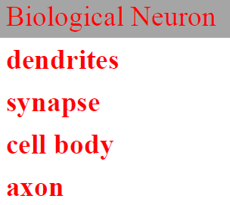
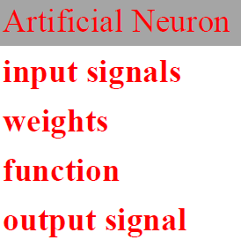
Introduction (8/9)

Slide 11
Introduction (9/9)
Bias and Weight
The bias b is much like a weight w, except that it has a constant input of 1. It can be omitted for some situation.
Bias b and weight w are both adjustable scalar parameters of the neuron. They can be adjusted by some learning rule so that the neuron input/output relationship meets some special goal.

Slide 12
Transfer Functions
The transfer function f may be a linear or nonlinear function of n
Three of the most commonly used functions
  Symmetrical Hard limit transfer function
  Linear transfer function
  Log-sigmoid transfer function

Slide 13
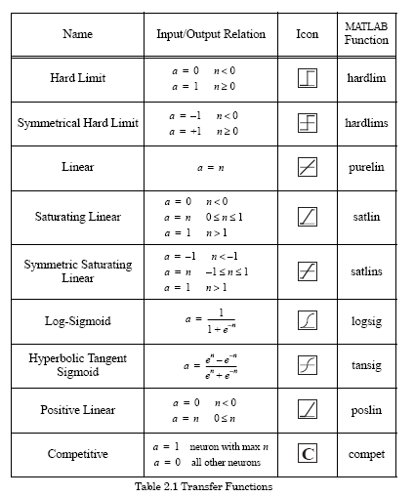
Other Transfer Functions

Slide 14
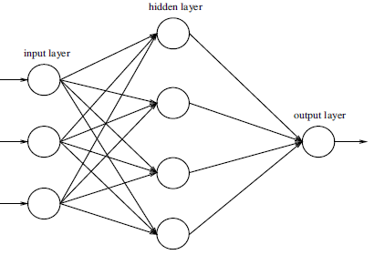
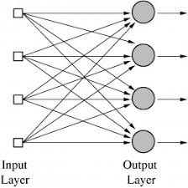
Network Structures

Slide 15
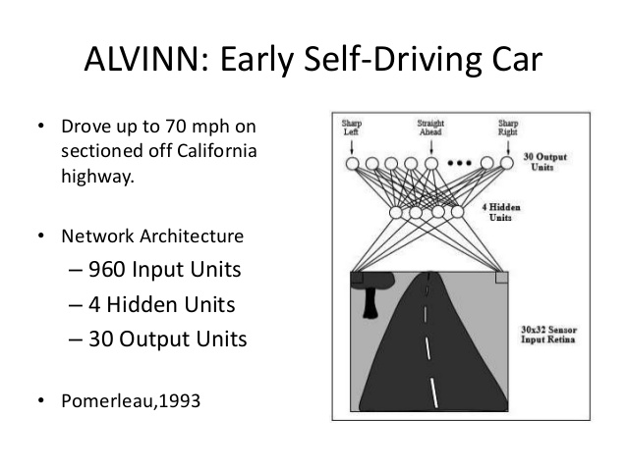
Autonomous Learning Vehicle in a Neural Net (ALVINN)

Slide 16
When to Consider Neural Networks
High dimensional inputs
Discrete or real-valued inputs and outputs
  More natural for real-valued
Multi-valued outputs
Noisy data
Human readability of result is unimportant
  “Black box”
    No human understandable interpretation of
    the learned function as in decision trees
Examples:
  Speech phoneme recognition
  Image classification
  Financial prediction

Slide 17
Perceptron (1/4)
Perceptron (an artificial neuron )
  Input: x₁, x₂, …,x_{n}
  Output: 1 or -1
x₀ = 1
x₁
w₁
w₀
x₂
w₂
Σ
x_{n}
w_{n}
,…

Slide 18
Perceptron (2/4)
Multiple real-valued inputs: (x₁, x₂, x₃, ..., x_{n} )
Single output: o(x₁, x₂, x₃, ..., x_{n} ) = 1 or -1
Input-output relationship:
In order to output a +1 for the percepton, the weighted
combination w₁x₁+…+ w_{n}x_{n} must surpass (-w₀ ).
i.e., -w₀ is a threshold
,…

Slide 19
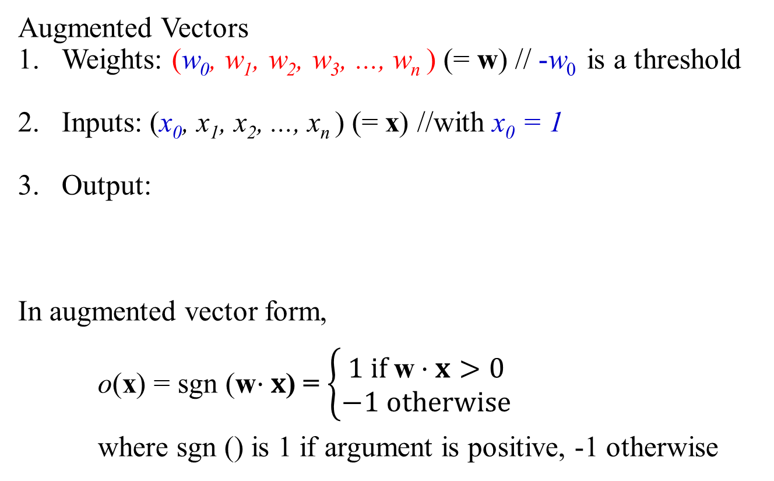
Perceptron (3/4)
Augmented Vectors
Weights: (w₀, w₁, w₂, w₃, ..., w_{n} ) (= w) // -w₀ is a threshold
Inputs: (x₀, x₁, x₂, ..., x_{n} ) (= x) //with x₀ = 1
Output:
In augmented vector form,
o(x) = sgn (w$⋅x$) = $\left\{\begin{aligned}1 if \text{w}⋅x>0 \\ −1 otherwise\end{aligned}\right.$
where sgn () is 1 if argument is positive, -1 otherwise
,…

Slide 20
Perceptron (4/4)
(w₀, w₁, w₂, w₃, ..., w_{n} ) is to be determined and to be fit in learning problem
(i.e., the space H of candidate hypothesis is the set of all possible
real-valued weight vectors H = {w| w ∈ R^{n+1}})

Slide 21
Decision Surface of a Perceptron (1/4)
x₂
+
+
-
+
x₁
-
-
The equation w₀ +w₁ x₁ + w₂ x₂ + ... + w_{n} x_{n}= 0
is a hyperplane in an n-dimensional space
An instance x = ( x₁ , x₂ , ... , x_{n}) is a point in in the
n-dimensional space
Perceptron represents a hyperplane decisions surface separating instances
  If instances can be separated (linearly separable), then perceptron can accurately represent the output mapping

Slide 22
Decision Surface of a Perceptron (2/4)
Represents some useful functions
  For example, Boolean functions
    Both inputs and output are Boolean values
    Assume Boolean values of +1 (true) and –1 (false)
  What weights represent AND (x₁, x₂)?
    w₀ = -0.8, w₁ = w₂ = 0.5
    o(x₁,x₂ ) = sgn(-0.8 + 0.5x₁ + 0.5 x₂ )

Slide 23
Decision Surface of a Perceptron (3/4)
Similarly
  OR (x₁, x₂)
    w₀ = 0.3, w₁ = w₂ = 0.5
    o(x₁,x₂ ) = sgn(0.3 + 0.5x₁ + 0.5 x₂ )
  NOT (x₁) :
    w₀ =0.0, w₁ = -1.0
    o(x₁) = sgn(0.0 –1.0x₁)

Slide 24
Decision Surface of a Perceptron (4/4)
x₂
+
-
x₁
-
+
But some functions can not be represented by a single percepton, i.e., not linearly separable.
  What weights represent XOR (x₁, x₂)?
  Not linearly separable
  Discouraged ANN research for ~10 years (Minsky & Papert, 1969)
Solution: use multilayer networks.

Slide 25
Perceptron Training Rule (1/3)
y = c(x₁, x₂, x₃, ..., x_{n} ) is the target value for some training example
o : Perceptron output for training example (x₁, x₂, x₃, ..., x_{n} )
(Note, here o is the output of Perceptron, not the target value)
Initialize weights (w_{0,} w₁, w₂, x₃, ...,w_{n} ) to random values
Loop through training examples:
  w_{i} ← w_{i}+ Δ w_{i}
  Where Δw_{i} = η (t-o)x_{i} and
  η is a learning rate (small positive value, e.g., 0.1)

Slide 26
Perceptron Training Rule (2/3)
Given training data set D = {(x, y)}
Algorithm
  Initialize all weights w_{i} to random values
  WHILE not all examples correctly predicted DO
    FOR each training example x = (x₁, x₂, x₃, ..., x_{n} ) ∈ D
      Compute current output o (x₁, x₂, x₃, ..., x_{n} )
      FOR i = 0 to n
        w_{i} ← w_{i} + η(y - o)x_{i} // let x₀=1 always

Slide 27
Perceptron Training Rule (3/3)
Note that
  If (y-o) = 0, no change in weight,
If training examples are linearly separable and small enough η is chosen, perceptron training rule is guaranteed to converge in finite number of iterations
What we can do if training examples are not linearly separable ?
  Approach 1: develop algorithm that will find closest approximation
        E.g., gradient descent method
  Approach 2: develop architecture (e.g., multiplayer networks) to
  overcome representational limitation

Slide 28
Gradient Descent (1/8)
The Gradient descent rule is also known as
  Delta rule
  ADALINE rule
  Widrow-Hoff rule
Converges toward a best-fit approximation to the target concept If the training examples are not linearly separable
Searches “hypothesis space” of (n+1)-dimensional real values to minimize training error of a hypothesis h (i.e.,weight vector W)
A common measure of training error: least-squares

Slide 29
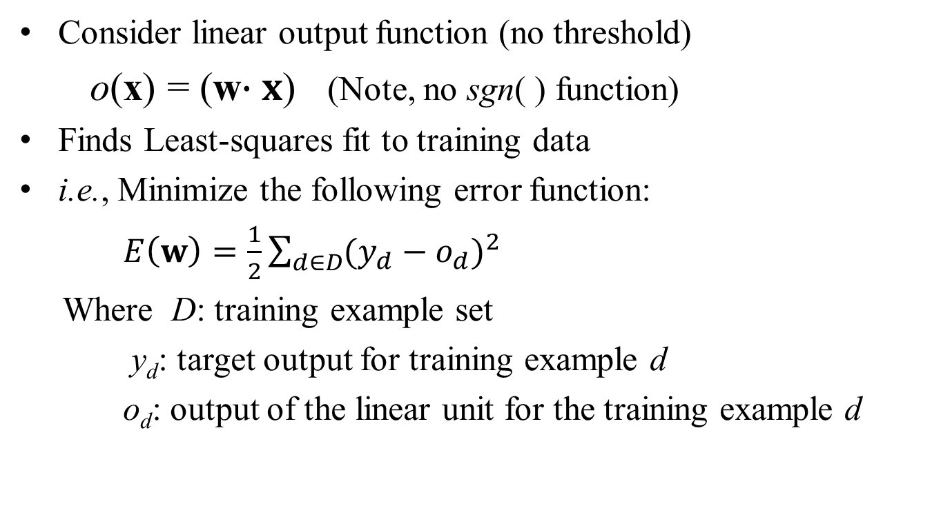
Gradient Descent (2/8)
Consider linear output function (no threshold)
o(x) = (w$∙x$) (Note, no sgn( ) function)
Finds Least-squares fit to training data
i.e., Minimize the following error function:
$E\left(w\right)=\frac{1}{2}\sum_{d∈D}{{(y_{d}−o_{d})}^{2}}$
Where D: training example set
y_{d}: target output for training example d
o_{d}: output of the linear unit for the training example d

Slide 30
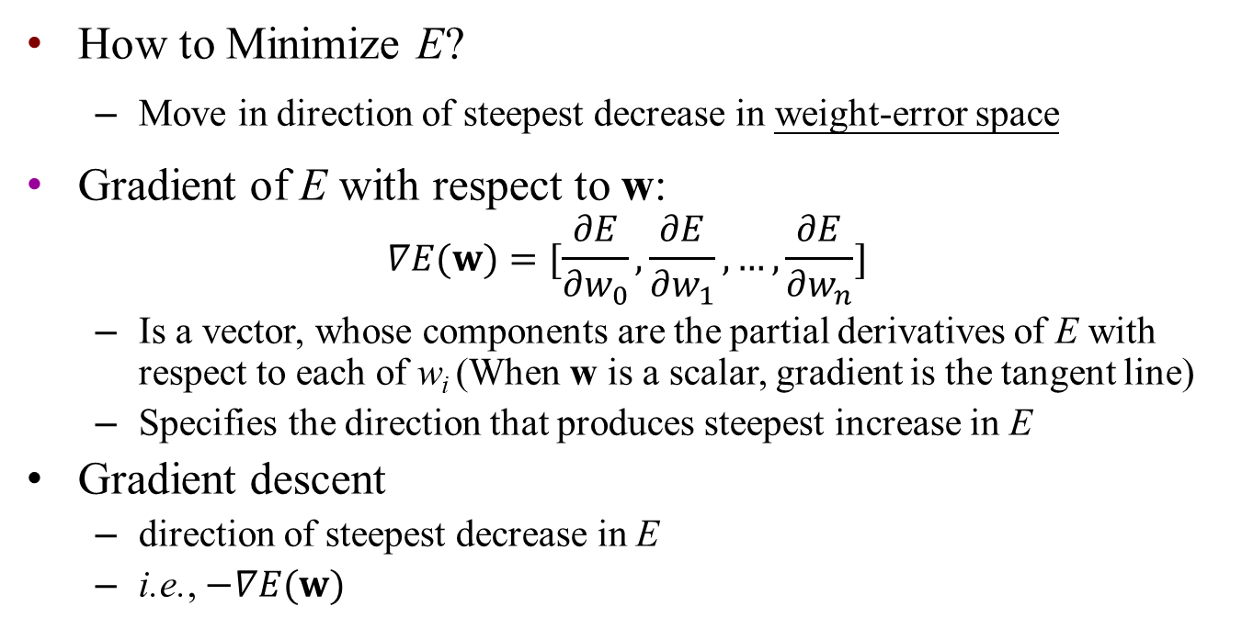
Gradient Descent (3/8)
How to Minimize E?
  Move in direction of steepest decrease in weight-error space
Gradient of E with respect to w:
$$∇E(w)=[\frac{∂E}{∂w_{0}}, \frac{∂E}{∂w_{1}},…,\frac{∂E}{∂w_{n}}]$$
  Is a vector, whose components are the partial derivatives of E with respect to each of w_{i} (When w is a scalar, gradient is the tangent line)
  Specifies the direction that produces steepest increase in E
Gradient descent
  direction of steepest decrease in E
  i.e., $−∇E(w)$

Slide 31
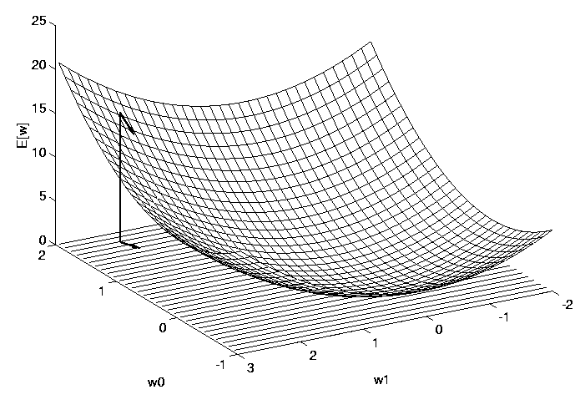
Gradient Descent (4/8)
Example: two weights: w = (w₀, w₁)
  Error surface E is parabolic (by definition)
  Single global minimum
  Arrow: negated gradient at one point
  Steepest descent along the surface

Slide 32
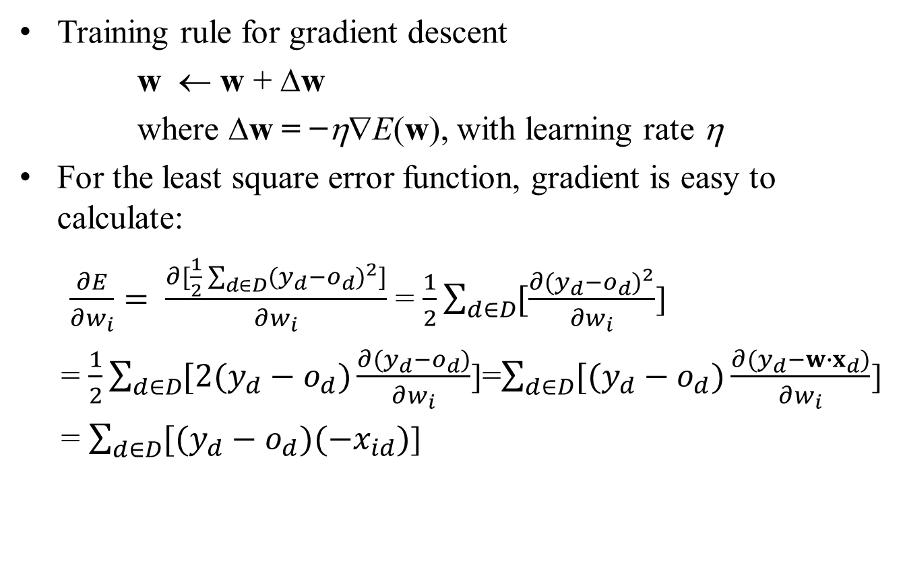
Gradient Descent (5/8)
Training rule for gradient descent
w ← w + Δw
where Δw = −η∇E(w), with learning rate η
For the least square error function, gradient is easy to calculate:
$\frac{∂E}{∂w_{i}}= \frac{∂[\frac{1}{2}\sum_{d∈D}{{(y_{d}−o_{d})}^{2}}]}{∂w_{i}}$ = $\frac{1}{2}\sum_{d∈D}{[\frac{∂{(y_{d}−o_{d})}^{2}}{∂w_{i}}}$]
= $\frac{1}{2}\sum_{d∈D}{[2(y_{d}−o_{d})\frac{∂(y_{d}−o_{d})}{∂w_{i}}}$]=$\sum_{d∈D}{[(y_{d}−o_{d})\frac{∂(y_{d}−w∙x_{d})}{∂w_{i}}}$]
= $\sum_{d∈D}{[(y_{d}−o_{d})(−x_{id})}$]

Slide 33

Gradient Descent (6/8)
We may write the rule in its component form
Δ$w_{i}$ = −η$\frac{∂E}{∂w_{i}}$ and $\frac{∂E}{∂w_{i}}=\sum_{d∈D}{[(y_{d}−o_{d})(−x_{id})}\text{]}$
The formula becomes

Slide 34
Gradient Descent (7/8)
Algorithm Gradient-Descent (training_examples D, η)_Batch Version
  Each training example is a pair of the form (x, y) , where x is the vector of input values and y is the target value. η is the learning rate (e.g., 0.05)
  Initialize each weight w_{i} to some small random value
  UNTIL the termination condition is met, DO
    //one iteration for whole training examples
    Initialize each Δw_{i} to zero
    FOR each (x, y) in training_examples D, DO //train each example
      Input the instance x to the unit and compute the output o
      FOR each linear unit weight w_{i}, DO //train each w_{i} for the given example
        Δw_{i} ← Δw_{i} + η (y - o)x_{i}
  FOR each linear unit weight w_{i}, DO //have trained all examples, update w_{i}
        w_{i} ← w_{i} + Δw_{i}

Slide 35
Gradient Descent (8/8)
Notes:
  Uses all of the training data in each iteration
  η must be sufficiently small to converge
    too large η → may oscillate
    common modification: gradually decrease learning rate η
  Not guaranteed to converge in finite number of iterations
  May find a local minimum
    Using incremental gradient descent (or call stochastic gradient descent) may help to avoid a local minimum
    i.e., Update weights on the basis of each training example rather doing sum over all data.

Slide 36
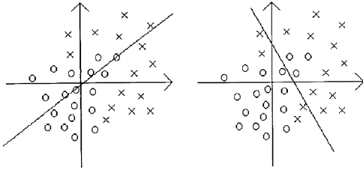
Perceptron Training Rule VS.
Gradient Descent Rule
For example, in the case of linearly inseparable problem:
Perceptron Training Rule;
Stop for a maximum number of epochs
Gradient Descent Rule

